Slide 1
Integrating OpenAI's ChatCompletion API with PostgreSQL

Slide 2
Brief Introduction
This code demonstrates how to use OpenAI's ChatCompletion API to generate a multi-step conversation and store the prompts and responses in a PostgreSQL database.

Slide 3
Tools and Technology used
OpenAI API key
PostgreSQL database set up and running
Python packages: openai, psycopg2, python-dotenv

Slide 4
Code overview
Set up OpenAI API key and PostgreSQL connection
Create a table to store prompts and responses
Define initial prompt and conversation generation function
Store initial prompt and response in the database
Prompt user for follow-up prompts and store them in the database
Close database connection

Slide 5
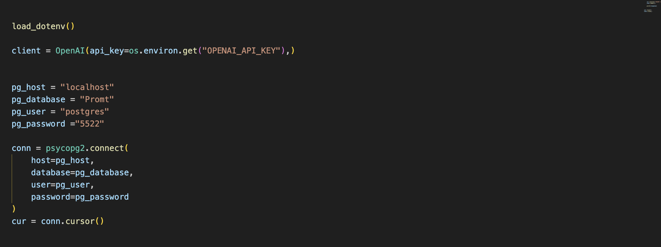
Code - Connection to the api and database

Slide 6
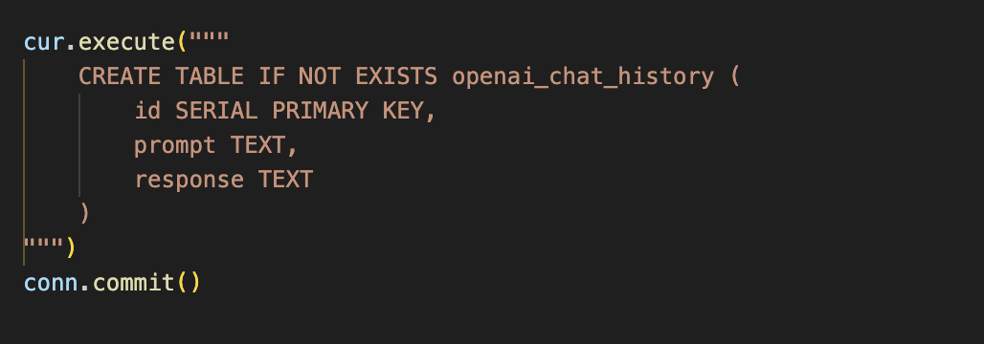
Creating Table for Prompts and Responses

Slide 7
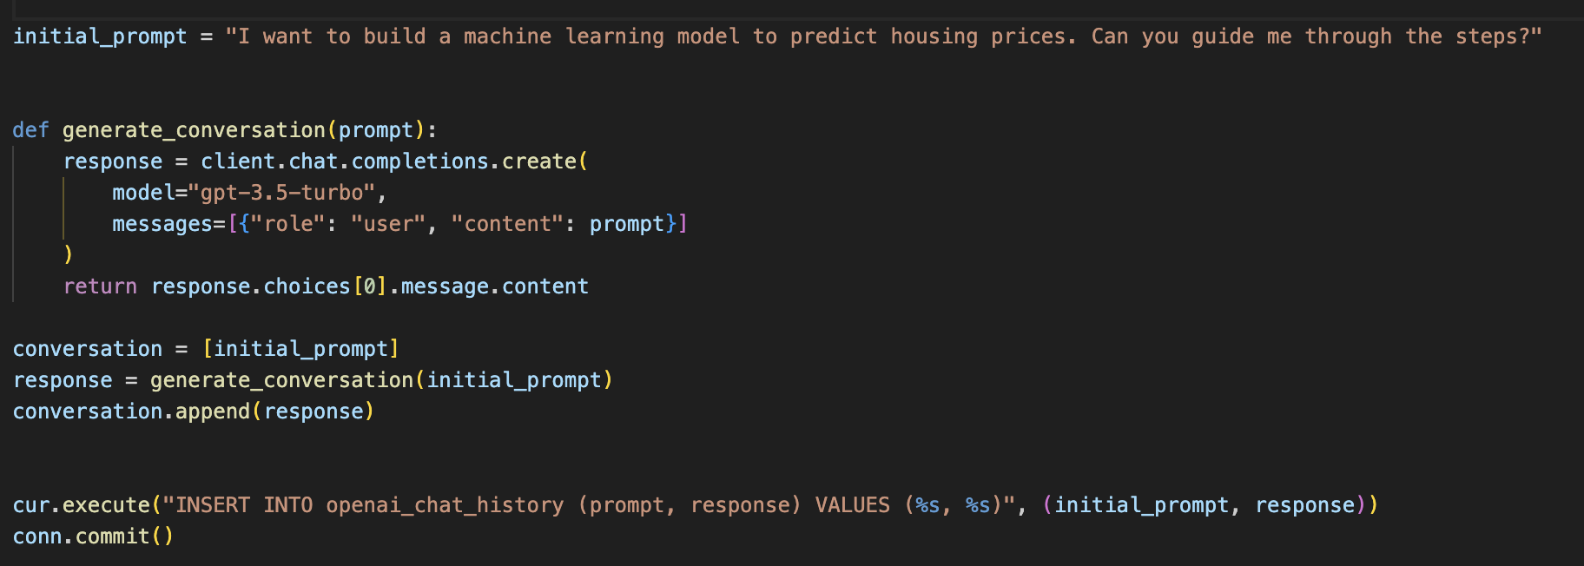
Prompt request

Slide 8
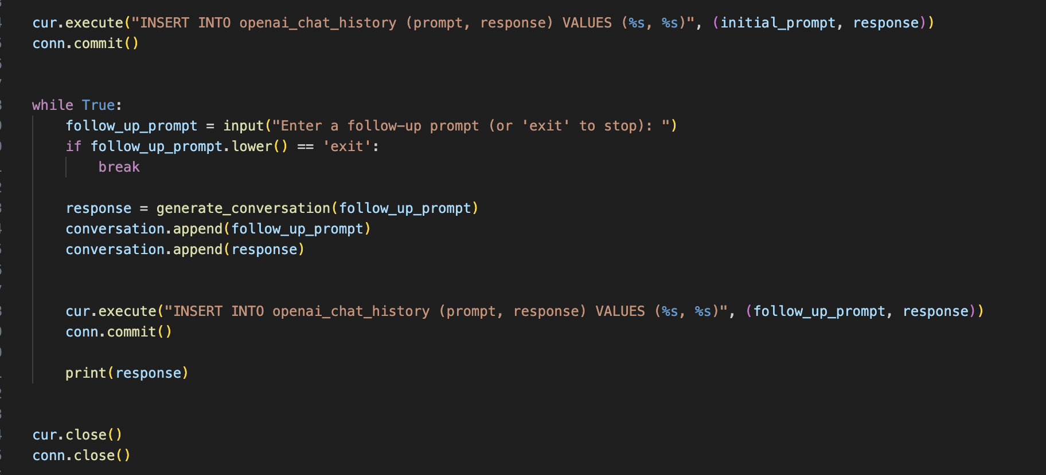
Storing the prompts

